Slide 1
Architecting Complexity
How Understanding Complexity Promotes Simplicity

Slide 2
Why is writing software hard?
^
great
Notes:
See if anyone in the room has any thoughts but don’t spend too much time on it

Slide 3
http://www.infoq.com/presentations/Simple-Made-Easy
Notes:
See if anyone in the room has any thoughts but don’t spend too much time on it

Slide 4
Our duty as software architects is to understand and manage complexity

Slide 5
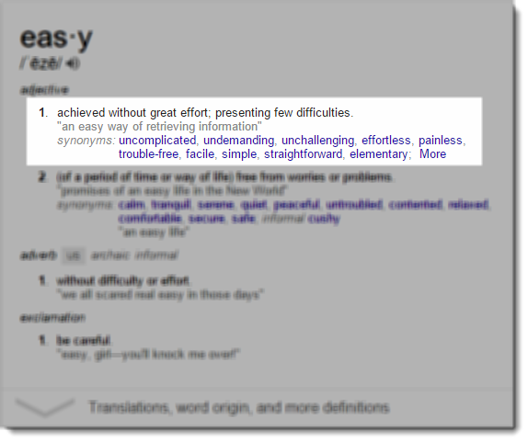
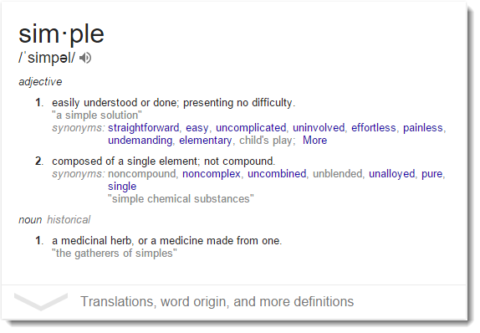
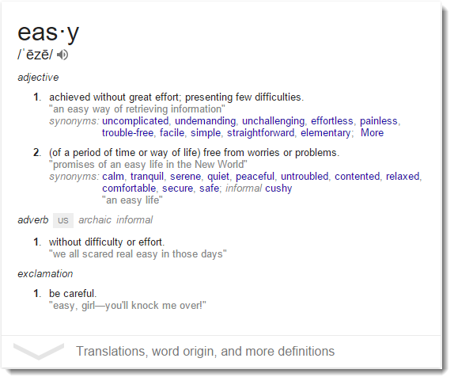
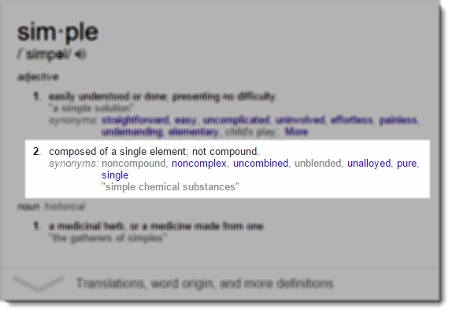
Simple is not Easy
Simple is objective
Easy is subjective
Notes:
Rich Hickey argued in his talk Simple Made Easy that simplicity is objective but easiness is subjective. Something is simple if it is singular: it does one thing, it is made of one thing, etc. Something is easy if it is close at hand, i.e. familiar.

Slide 6
Simple is not Easy
Simple is to Complex
As
Easy is to Hard
Notes:
Rich Hickey argued in his talk Simple Made Easy that simplicity is objective but easiness is subjective. Something is simple if it is singular: it does one thing, it is made of one thing, etc. Something is easy if it is close at hand, i.e. familiar.

Slide 7
Simple is not Easy
Development Speed
Time
Notes:
If you ignore complexity you will invariably slow down over the long haul.

Slide 8
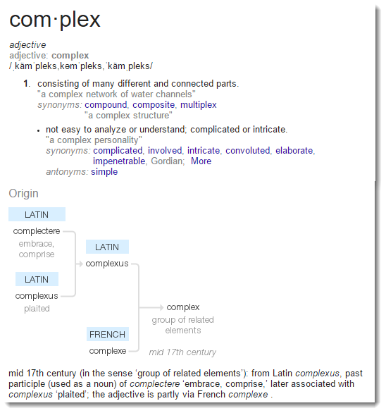
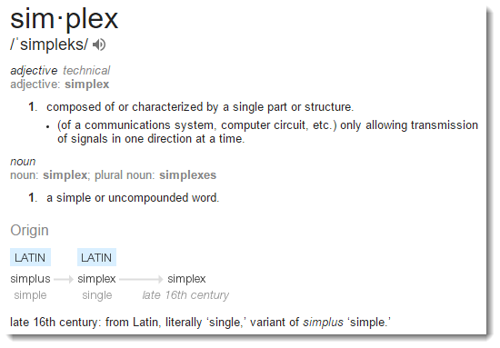
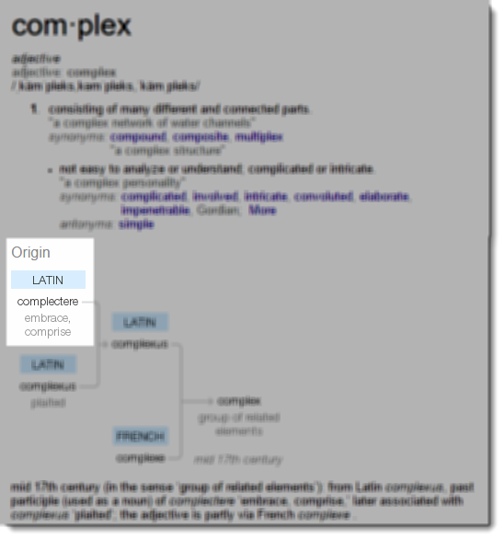
Simple vs Complex
Simple
Complex
Notes:
Rich Hickey does something very interesting in his talk, he looks at the roots of the words simple and complex and uses the ideas of braids to express the difference

Slide 9
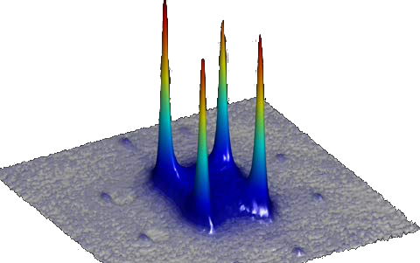
Complexity
Complexity is analogous to heat and simplicity is analogous to cold
There is no such thing as cold, just absence of heat
We can never add simplicity, only remove complexity
Notes:
Absolute zero by definition contains no heat
There is no absolute heat, things can always get hotter
We can never add simplicity, only remove complexity. The functionality required by our application places a lower limit on the complexity required.

Slide 10
Software Complexity
“The true meaning of software complexity is the difficulty to maintain, change and understand software”
-H. Zuse, Software Complexity Measures and Models
Notes:
Epistemic complexity relates to the predictability of system properties when changes are proposed. If you don’t have enough knowledge of the system and it’s components, you cannot make predictions about it, even if the system does not have dynamic, dependent relationships between components.
Complexity is not only a property of the system, but also a property of the system observer (software developer). If an expert has knowledge of a system and can reliably make changes, but then gets hit by a bus, his/her replacement may never be able to accrue the same level of understanding because he/she didn’t do the original work.
We can’t capture this component of complexity, but we can lessen its impact on our system by managing the dependent relationship between components.

Slide 11
Software Complexity
Understanding Software
Testing
Reasoning
Trying to understand the software from the outside
Trying to understand the software from the inside
Notes:
Testing This is attempting to understand a system from the outside — as a “black box”. Conclusions about the system are drawn on the basis of observations about how it behaves in certain specific situations. Testing may be performed either by human or by machine. The former is more common for whole-system testing, the latter more common for individual component testing.
Informal Reasoning This is attempting to understand the system by examining it from the inside. The hope is that by using the extra information available, a more accurate understanding can be gained.

Slide 12
Software Complexity
Understanding Software
Testing
Reasoning
Cyclomatic Complexity
Coupling
Cohesion
Size
Notes:
There are metrics associated with how complexity effects our ability to understand the software system.
One application of cyclomatic complexity is determining the number of test cases that are necessary to achieve thorough test coverage of a particular module. As a note, cyclomatic complexity definitely plays into our ability to reason about our software, but I think that coupling/cohesion/size are factors that drive cyclomatic complexity

Slide 13
Epistemic Complexity
"The richness of the knowledge that is embedded in an artifact"
-Dasgupta
Understanding Software
Developers
Customers
Reasoning
Coupling
Cohesion
Size
Observer
Notes:
Epistemic complexity relates to the predictability of system properties when changes are proposed. If you don’t have enough knowledge of the system and it’s components, you cannot make predictions about it, even if the system does not have dynamic, dependent relationships between components.
Complexity is not only a property of the system, but also a property of the system observer (software developer). If an expert has knowledge of a system and can reliably make changes, but then gets hit by a bus, his/her replacement may never be able to accrue the same level of understanding because he/she didn’t do the original work.
We can’t capture this component of complexity, but we can lessen its impact on our system by managing the dependent relationship between components.

Slide 14
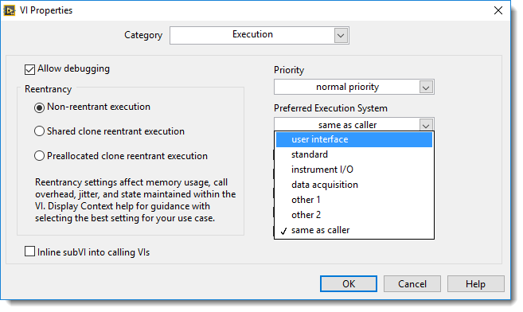
Environmental Complexity
Resource Contention
CPU
RAM
Segmentation
Execution System
Root Loop
Notes:
The primary status of complexity as the major cause of these other problems comes simply from the fact that being able to understand a system is a prerequisite for avoiding all of them, and of course it is this which complexity destroys.

Slide 15
Software Complexity
Complexity is the root cause of the vast majority of problems with our software
Unreliability
Late delivery
Poor performance
Notes:
The primary status of complexity as the major cause of these other problems comes simply from the fact that being able to understand a system is a prerequisite for avoiding all of them, and of course it is this which complexity destroys.

Slide 16
Complexity Metric: Coupling
Coupling is the degree of interdependence between software modules
A change in one module usually forces changes in other modules
Assembly of modules requires more time and effort due to inter-module dependency
Modules might be harder to reuse and or/test

Slide 17
Complexity Metric: Coupling
CBO: Coupling Between Objects
Number of classes to which a class is coupled
Two classes are coupled when methods declared in one class use methods defined by another class
Multiple access to the same class are counted as one access
High CBO is undesirable: CBO>14 is too high
Shyam R. Chidamber, Chris F. Kemerer. A Metrics suite for Object Oriented design. M.I.T. Sloan School of Management E53-315. 1993.
Victor Basili, Lionel Briand and Walcelio Melo. A Validation of Object-Oriented Design Metrics as Quality Indicators. IEEE Transactions on Software Engineering. Vol. 22, No. 10, October 1996.
Lionel C. Briand, John W. Daly, and Jürgen Wüst: A Unified Framework for Coupling Measurement in Object-Oriented Systems. Fraunhofer Institute for Experimental Software Engineering. Kaiserslautern, Germany. 1996
Houari A. Sahraoui, Robert Godin, Thierry Miceli: Can Metrics Help Bridging the Gap Between the Improvement of OO Design Quality and Its Automation?

Slide 18
Complexity Metric: Cohesion
Cohesion is the degree to which the elements of a module belong together
High cohesion reduces module complexity
High cohesion increases system maintainability
High Cohesion increases module reusability

Slide 19
Complexity Metric: Cohesion
LCOM4: Lack of Cohesion of Methods
LCOM4 = 1 indicates a cohesive class
LCOM4 >=2 indicates a potential for low cohesion
LCOM4 = 0 indicates a class with no methods
Hitz M., Montazeri B.: Measuring Coupling and Cohesion In Object-Oriented Systems. Proc. Int. Symposium on Applied Corporate Computing, Oct. 25-27, Monterrey, Mexico, 75-76, 197, 78-84

Slide 20
Complexity Metric: Cohesion
A
C
D
A
C
D
B
E
B
E
x
Y
x
Y
LCOM4 = 2
This class consists of 2 unrelated components. You could split it as {A, B, x} and {C, D, E, y}
LCOM4 = 1
This class consists of a single component. It is a cohesive class

Slide 21
Complexity Metric: Size
WMC: Weighted Method Count
WMC is a predictor of how much time and effort is required to develop and maintain the class
A large number of methods means greater potential impact of change on derived classes
10% of classes can have more than 24 methods
Shyam R. Chidamber, Chris F. Kemerer. A Metrics suite for Object Oriented design. M.I.T. Sloan School of Management E53-315. 1993.
Victor Basili, Lionel Briand and Walcelio Melo. A Validation of Object-Oriented Design Metrics as Quality Indicators. IEEE Transactions on Software Engineering. Vol. 22, No. 10, October 1996

Slide 22
Complexity Metric: Case Study
System Analyzed | Java | C++ | Java
Classes | 46 | 1617 | 1000
Lines | 50,000 | 500,000 | 300,000
CBO | 2.48 | 2.09 | 1.25
LCOM | 447.65 | 113.94 | 78.34
RFC | 80.39 | 28.60 | 43.84
NOC | 0.07 | 0.39 | 0.35
DIT | 0.37 | 1.02 | 0.97
WMC | 45.7 | 23.97 | 11.10
Quality | LOW | MEDIUM | HIGH
Laing, Victor & Coleman, Charles: Principal Components of Orthogonal Object-Oriented Metrics. White Paper Analyzing Results of NASA Object-Oriented Data. SATC, NASA, 2001. http://satc.gsfc.nasa.gov/support/OSMASAS_SEP01/Principal_Components_of_Orthogonal_Object_Oriented_Metrics.pdf

Slide 23
Complexity Metric: Case Study
System Analyzed | Java | C++ | Java
Classes | 46 | 1617 | 1000
Lines | 50,000 | 500,000 | 300,000
CBO | 2.48 | 2.09 | 1.25
LCOM | 447.65 | 113.94 | 78.34
RFC | 80.39 | 28.60 | 43.84
NOC | 0.07 | 0.39 | 0.35
DIT | 0.37 | 1.02 | 0.97
WMC | 45.7 | 23.97 | 11.10
Quality | LOW | MEDIUM | HIGH
Laing, Victor & Coleman, Charles: Principal Components of Orthogonal Object-Oriented Metrics. White Paper Analyzing Results of NASA Object-Oriented Data. SATC, NASA, 2001. http://satc.gsfc.nasa.gov/support/OSMASAS_SEP01/Principal_Components_of_Orthogonal_Object_Oriented_Metrics.pdf

Slide 24
Demo: Class Analyzer

Slide 25
How do we use this information?

Slide 26
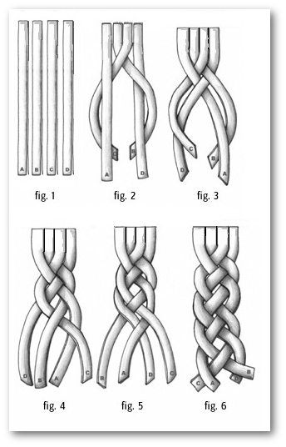
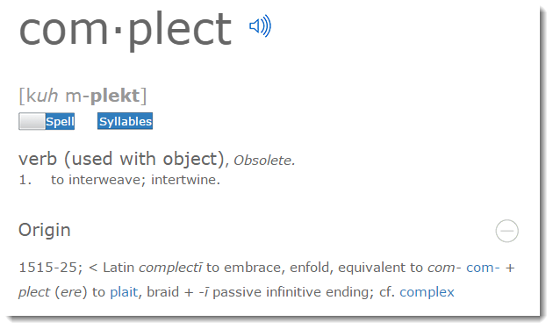
Complect
Notes:
Figure 1 shows 4 strings entirely separated from each other. As the four strings are braided in figures 2-6, they become increasing more and more complected, and the complexity of the braided system increases
Rich Hickey introduces the term complect in his talk Simple Made Easy

Slide 27
SOLID Software
Dependency Inversion Principle: Control your coupling
Single Responsibility Principle: Control your cohesion
Open/Closed Principle: Aid cohesion by closing your classes to the most common kinds of change
Interface Segregation Principle: Carrying around unused methods will hurt cohesion and size
Liskov Substitution Principle: Code the fulfills its contracts is easier to reason about and test
Notes:
Figure 1 shows 4 strings entirely separated from each other. As the four strings are braided in figures 2-6, they become increasing more and more complected, and the complexity of the braided system increases
Rich Hickey introduces the term complect in his talk Simple Made Esy

Slide 28
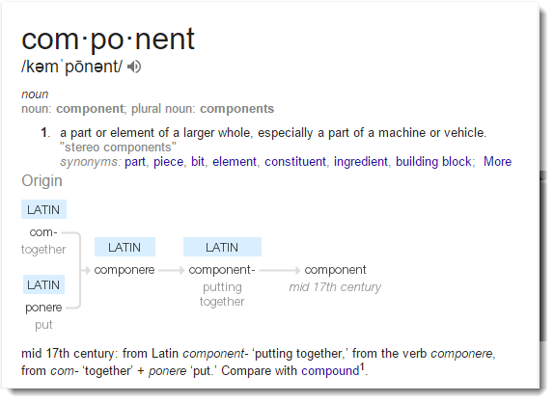
Composed Software
Componentized Software: Move the complexity management up a level of abstraction

Slide 29
Summary
Complexity impairs our ability to reason about our code
Simplicity improves our ability to understand, change, and test our code
Using complexity metrics can help us manage technical debt and improve quality
Notes:
Robert Martin lists these 7 code smells as being symptoms of bad software. Each of these 7 code smells is a symptom of complexity

Slide 30
Simple is not Easy
“…we have to keep it crisp, disentangled, and simple if we refuse to be crushed by the complexities of our own making”
- Dijkstra
Notes:
Complexity is the root cause of the vast majority of problems with software today. Unreliability, late delivery, lack of security — often even poor performance in large-scale systems can all be seen as deriving ultimately from unmanageable complexity. The primary status of complexity as the major cause of these other problems comes simply from the fact that being able to understand a system is a prerequisite for avoiding all of them, and of course it is this which complexity destroys.

Slide 31
How does this fit with Agile?
Notes:
Robert Martin lists these 7 code smells as being symptoms of bad software. Each of these 7 code smells is a symptom of complexity

Slide 32
Agile Complexity
Understanding Software
Testing
Reasoning
Test Driven Design
Trying to understand the software from the outside
Scrum, XP
Trying to understand the software from the inside
Notes:
Testing This is attempting to understand a system from the outside — as a “black box”. Conclusions about the system are drawn on the basis of observations about how it behaves in certain specific situations. Testing may be performed either by human or by machine. The former is more common for whole-system testing, the latter more common for individual component testing.
Informal Reasoning This is attempting to understand the system by examining it from the inside. The hope is that by using the extra information available, a more accurate understanding can be gained.

Slide 33
Is Emergent Design Sustainable?
Simple
Sprint
Release
Problem
Plan
Complex
Sprint 1
Sprint 2
Sprint 3
Sprint 4
Sprint 5
Simple
Complex
Solution
Notes:
Complexity is the root cause of the vast majority of problems with software today. Unreliability, late delivery, lack of security — often even poor performance in large-scale systems can all be seen as deriving ultimately from unmanageable complexity. The primary status of complexity as the major cause of these other problems comes simply from the fact that being able to understand a system is a prerequisite for avoiding all of them, and of course it is this which complexity destroys.
Agile approaches help us reason about complex and dynamic problems
Agile Architects use complexity metrics to help mold the design of the software
Agile architecture should not be emergent

Slide 34
Links
https://hbr.org/2011/09/learning-to-live-with-complexity
http://www.johndcook.com/blog/2011/11/11/simple-versus-easy/
http://shaffner.us/cs/papers/tarpit.pdf
https://blog.8thlight.com/uncle-bob/2011/10/20/Simple-Hickey.html
http://www.slideshare.net/jws7/software-complexity-8456531?next_slideshow=1
https://www.youtube.com/watch?v=TMuno5RZNeE
http://www.infoq.com/presentations/Simple-Made-Easy
http://press.princeton.edu/titles/8429.html
http://www.acis.pamplin.vt.edu/faculty/tegarden/wrk-pap/DSS.PDF
http://www.codingthearchitecture.com/presentations/sa2011-just-enough-up-front-design

Slide 35
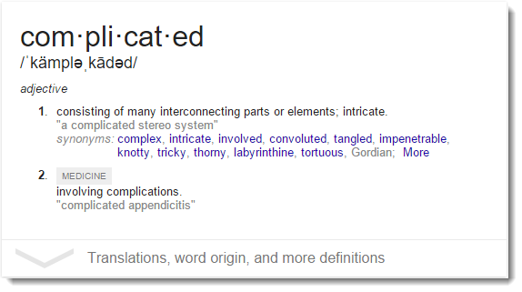
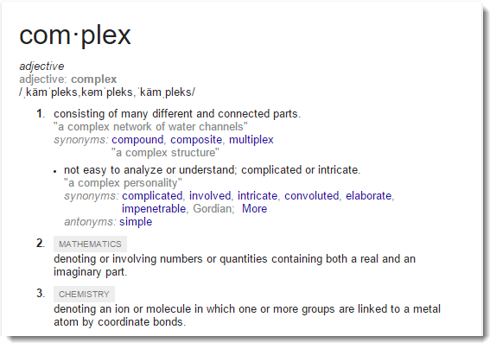
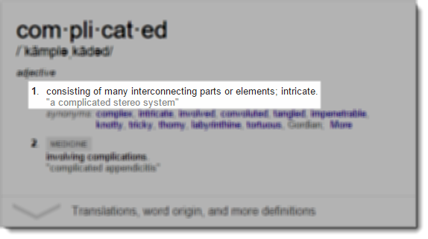
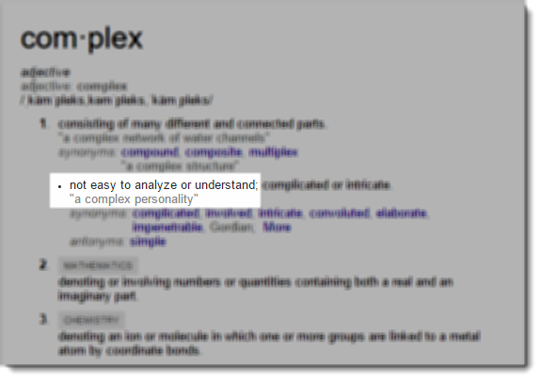
Complex vs Complicated
Complex
Complicated
Notes:
Rich Hickey does something very interesting in his talk, he looks at the roots of the words simple and complex and uses the ideas of braids to express the difference

Slide 36
Complex vs Complicated
“Complexity arises when the dependencies among the elements become important. In such a system, removing one such element destroys behavior to an extent that goes well beyond what is embodied by the particular element that is removed”
-John Miller & Scott Page, Complex Adaptive Systems

Slide 37
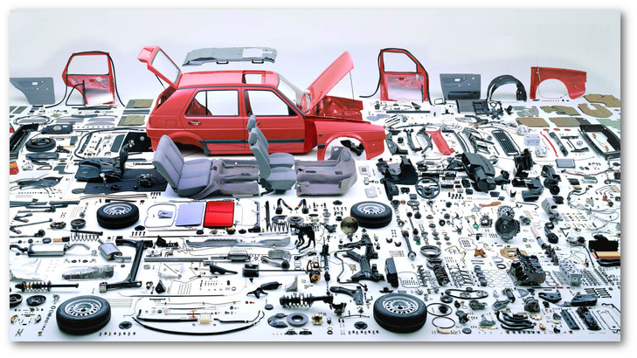
Complex vs Complicated
Notes:
Three properties determine the complexity of an environment. The first, multiplicity, refers to the number of potentially interacting elements. The second, interdependence, relates to how connected those elements are. The third, diversity, has to do with the degree of their heterogeneity. The greater the multiplicity, interdependence, and diversity, the greater the complexity. An organic growth program, for example, is highly complex—it contains a large number of interactive, interdependent, diverse elements.
It’s possible to understand both simple and complicated systems by identifying and modeling the relationships between the parts; the relationships can be reduced to clear, predictable interactions. It’s not possible to understand complex systems in this way, because all the elements are interacting continuously and unpredictably.
If removing a cars seats causes the car not to start then there is complexity in the system.

