Slide 1
Principles of Package Design
Compose at A higher level of abstraction

Slide 2
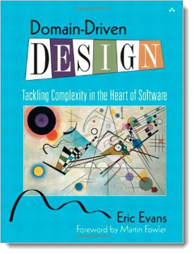

Slide 3
As applications grow in size and complexity they require some kind of high-level organization

Slide 4
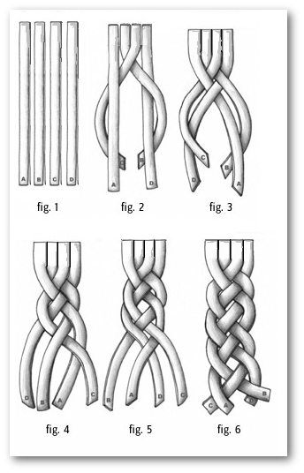

Slide 5
Grouping code into packages provides two benefits
It allows us to reason about the design at a higher level of abstraction
Package Coupling
It helps us manage the development and distribution of the software
Package Cohesion

Slide 6
What is a package?
^
LabVIEW
Notes:
Talk about what containers we have available to us in LabVIEW. LVLIB, PPL, VIP, PROJ?

Slide 7
Principles of Package Design
Package Cohesion
Reuse-Release Equivalence Principle (REP)
Common-Reuse Principle (CRP)
Common-Closure Principle (CCP)
Package Coupling
Acyclic-Dependencies Principle (ADP)
Stable-Dependencies Principle (SDP)
Stable-Abstractions Principle (SAP)

Slide 8
Package Cohesion
The three principles of package cohesion provide guidance on how to partition classes into packages

Slide 9
Reuse-Release Equivalence Principle
“The granule of reuse is the granule of release”
- Bob Martin
Notes:
The Reuse-Release Equivalence Principle (REP) - The REP tells us that classes should be packaged together because they are used together. This seems obvious, but many package structures are instead based around ideas like "functional areas," "architectural layers," or "originating team." It urges us to group things together for user convenience. An entire system shoehorned into a single package/library would comply with this principle. But if the rate of change in the library was not extremely low, it would suffer from the problems addressed by the remaining principles.

Slide 10
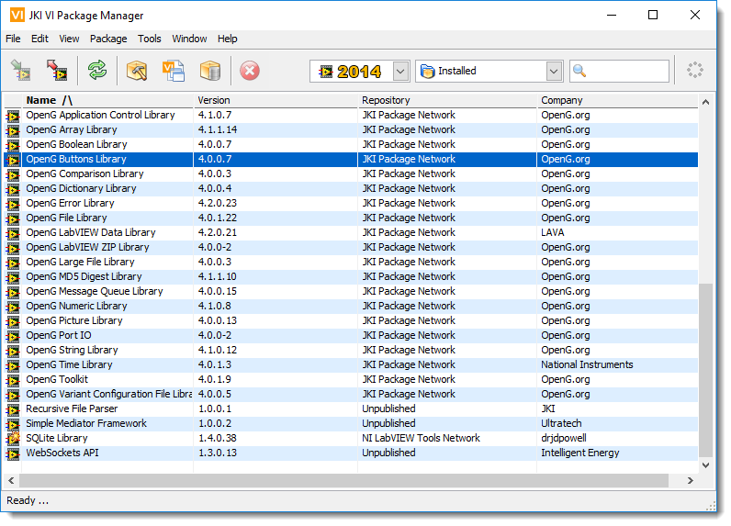
Reuse-Release Equivalence Principle
Reusability comes only after there is a tracking system in place that offers the guarantees of notification, safety, and support

Slide 11
Reuse-Release Equivalence Principle
What does this tell us about the internal structure of the package?
If a package contains software designed for reuse then it should not also contain software designed not for reuse
All software in a package should be reusable by the same audience

Slide 12
Reuse-Release Equivalence Principle
Summary
Packages should be easy for users to use
Packages should be released through a tracking system
For a package to be reusable, all of its classes should be reusable
Notes:
It can be argued that classes themselves can be used for distribution and usage. However, if we follow the basic design principles, we will always endup with more than one class, which communicate with each other. If individual classes are released, the version tracking and compatibility might be a nightmare. So, the unit of release has to be something bigger than the class – which we call package. Hence, packages are the granular units of release and hence reuse even if classes can be the units of design.
Group components (classes) for reusers
Single classes are usually not reuseable
Several collaborating classes make up a package
Classes in a package should form a reuseable and releaseable module
Module provides coherent functionality
Dependencies on other packages controlled
Requirements on other packages specified
Reduces work for the reuser

Slide 13
Common-Reuse Principle
“The classes in a package are reused together. If you reuse one of the classes in a package, you reuse them all”
- Bob Martin
Notes:
The Common-Reuse Principle (CRP) - This almost seems like a restatement of the REP, but the emphasis here is on limiting the impact to consumers. Imagine an API package with two sets of reusable class clusters. A programmer might choose to consume only one reusable component, but changes to the other component necessitate redistribution of the entire package. An unwanted release unnecessarily burdens the consuming programmer, who must re-integrate and re-test the entire library in order to stay current. Where the REP leads us to conglomerate, the CRP leads us to split packages apart. This tension between the principles leads us to find the level of granularity that provides greatest convenience (least negative impact) to users. In spirit, the CRP is a package-level restatement of the Interface Segregation Principle, which says to keep interfaces small and focused for similar reasons.

Slide 14
Common-Reuse Principle
It is typical for classes in a package to be tightly coupled
It should be impossible to depend on some classes in a package without depending on all classes in a package
Notes:
When a user is only interested in a few classes of a package
the user code still depends on all dependencies of the package
the user code must be recompiled/relinked and retested after a new release of the package, even if the actually used classes didn't change

Slide 15
Common-Reuse Principle
SRP: Classes should have only one reason to change
CRP: Classes in a package should be reused together
Notes:
When a user is only interested in a few classes of a package
the user code still depends on all dependencies of the package
the user code must be recompiled/relinked and retested after a new release of the package, even if the actually used classes didn't change

Slide 16
Common-Reuse Principle
Summary
Group classes according to common reuse
CRP is SRP applied to packages
Classes which are not tightly bound to each other should not be packaged together

Slide 17
Common-Closure Principle
“The classes in a package should be closed together against the same kinds of changes”
- Bob Martin
Notes:
The Common-Closure Principle (CCP) - The CCP is an application of the Open-Closed Principle at the next level up. This principle suggests that you should group your classes around the impact of change. A change should optimally impact only one package; as many other packages as possible should be closed to that change. This varies from the other two principles as it recommends grouping classes around the way the code is maintained, rather than the way it is used. Modules with a high rate of change might need to be grouped by closure rather than by use. Highly stable packages might be better conglomerated (REP).

Slide 18
Common-Closure Principle
The classes in a package should be closed together against the same kind of changes. A change that affects a package affects all the classes in that package

Slide 19
Common-Closure Principle
The classes in a package should be closed together against the same kind of changes. A change that affects a package affects all the classes in that package

Slide 20
Common-Closure Principle
OCP: Classes should be open for extension, but closed for modification
CCP: Classes in a package should be closed to the same kinds of changes
Notes:
Even though most of the class design principles advocate loose coupling between classes, so that they can change without affecting the other, dependencies between classes cannot be avoided. CCP tries to look at classes that are dependent on each other from a code change perspective. Even though Open-Closed Principle (OCP) recommends full closure to code change, it is not always possible. Sometimes some of the class design principles are violated consciously to improve performance. However this violation should be a conscious decision and the product should be ready for changes because of it.

Slide 21
Common-Closure Principle
Summary
Packages should be closed to anticipated changes
CCP is OCP applied to packages
CCP reduces package release frequency
Notes:
To enable easy distribution/update/release and maintainability, it is advisable to localize the changes to a package. Only the modified package can then be released, making the update easier. Even if the changes cannot be restricted to a single package, minimal packages should be required to be changed.

Slide 22
Package Cohesion
Summary
In choosing classes to include in packages we have to balance reusability and developability
This balancing act will cause the composition of the packages to change over time
The partitioning of classes into packages cannot happen until after the classes and their interrelationships have been created
There are no metrics for package cohesion
Notes:
The principles of package cohesion are not absolute. Sometimes a packaging may satisfy all three principles at once, but often the principles represent competing principles. The development team will have to make trade-offs in order to find a balance that works. In general, smaller (and even smaller) packages provide the best chance for adherence to the CCP and CRP principles, although the REP says there is a limit to how small you will want to go.
Following these principles will require occasional re-packaging, which is upsetting to many users. However, correcting less-than-optimal packaging is a single deep cut that can halt the "death of a thousand paper cuts" caused when changes ripple across packages, or when users of a package have to deal with frequent irrelevant updates.

Slide 23
Package Coupling
The three principles of package coupling deal with the relationships between packages

Slide 24
Acyclic-Dependencies Principle
“Allow no cycles in the package-dependency graph”
- Bob Martin
Notes:
Acyclic-Dependencies Principle (ADP) - You stay late to finish up some work, but come in the next morning only to find that your code is broken--someone else stayed later and checked in changes that make your code very unhappy. Fixing your code breaks a third developer's code, and his fixes break yours again. This "morning-after syndrome" can be an unending nightmare of changes breaking other code, which in turn must be changed, which in turn... Cycles begin to make all packages dependent upon all other packages in the system. They dramatically increase build times to the point of pain (something one of us lives with daily on the C++ project he's working). Some languages, like C#, have facilities to prevent circular dependencies among packages. But even modern, dynamic languages like Python can suffer in surprising ways from round-trip dependencies. Dependency cycles among modules are a very serious problem, slowing development and wrecking deadlines. Note that mutual dependencies among classes are usually a problem if the classes are split across modules/packages/assemblies.

Slide 25
Acyclic-Dependencies Principle
Acyclic Dependencies Principle: The dependency structure for the package must be a Directed Acyclic Graph (DAG) where nodes are packages and edges are dependencies
Notes:
Acyclic-Dependencies Principle (ADP) - You stay late to finish up some work, but come in the next morning only to find that your code is broken--someone else stayed later and checked in changes that make your code very unhappy. Fixing your code breaks a third developer's code, and his fixes break yours again. This "morning-after syndrome" can be an unending nightmare of changes breaking other code, which in turn must be changed, which in turn... Cycles begin to make all packages dependent upon all other packages in the system. They dramatically increase build times to the point of pain (something one of us lives with daily on the C++ project he's working). Some languages, like C#, have facilities to prevent circular dependencies among packages. But even modern, dynamic languages like Python can suffer in surprising ways from round-trip dependencies. Dependency cycles among modules are a very serious problem, slowing development and wrecking deadlines. Note that mutual dependencies among classes are usually a problem if the classes are split across modules/packages/assemblies.

Slide 26
Acyclic-Dependencies Principle
1
MyApp
2
3
4
MsgWindw
TaskWindw
MyTasks
5
Database
7
8
Tasks
MyDialogs
6
Windows
Notes:
Acyclic-Dependencies Principle (ADP) - You stay late to finish up some work, but come in the next morning only to find that your code is broken--someone else stayed later and checked in changes that make your code very unhappy. Fixing your code breaks a third developer's code, and his fixes break yours again. This "morning-after syndrome" can be an unending nightmare of changes breaking other code, which in turn must be changed, which in turn... Cycles begin to make all packages dependent upon all other packages in the system. They dramatically increase build times to the point of pain (something one of us lives with daily on the C++ project he's working). Some languages, like C#, have facilities to prevent circular dependencies among packages. But even modern, dynamic languages like Python can suffer in surprising ways from round-trip dependencies. Dependency cycles among modules are a very serious problem, slowing development and wrecking deadlines. Note that mutual dependencies among classes are usually a problem if the classes are split across modules/packages/assemblies.

Slide 27
Acyclic-Dependencies Principle
 | 1 | 2 | 3 | 4 | 5 | 6 | 7 | 8
1 | 0 | 1 | 1 | 1 | 0 | 0 | 0 | 0
2 | 0 | 0 | 0 | 0 | 0 | 1 | 0 | 0
3 | 0 | 0 | 0 | 0 | 0 | 1 | 1 | 1
4 | 0 | 0 | 0 | 0 | 1 | 1 | 1 | 1
5 | 0 | 0 | 0 | 0 | 0 | 0 | 0 | 0
6 | 0 | 0 | 0 | 0 | 0 | 0 | 0 | 0
7 | 0 | 0 | 0 | 0 | 0 | 0 | 0 | 0
8 | 0 | 0 | 0 | 0 | 0 | 1 | 0 | 0
Notes:
Acyclic-Dependencies Principle (ADP) - You stay late to finish up some work, but come in the next morning only to find that your code is broken--someone else stayed later and checked in changes that make your code very unhappy. Fixing your code breaks a third developer's code, and his fixes break yours again. This "morning-after syndrome" can be an unending nightmare of changes breaking other code, which in turn must be changed, which in turn... Cycles begin to make all packages dependent upon all other packages in the system. They dramatically increase build times to the point of pain (something one of us lives with daily on the C++ project he's working). Some languages, like C#, have facilities to prevent circular dependencies among packages. But even modern, dynamic languages like Python can suffer in surprising ways from round-trip dependencies. Dependency cycles among modules are a very serious problem, slowing development and wrecking deadlines. Note that mutual dependencies among classes are usually a problem if the classes are split across modules/packages/assemblies.

Slide 28
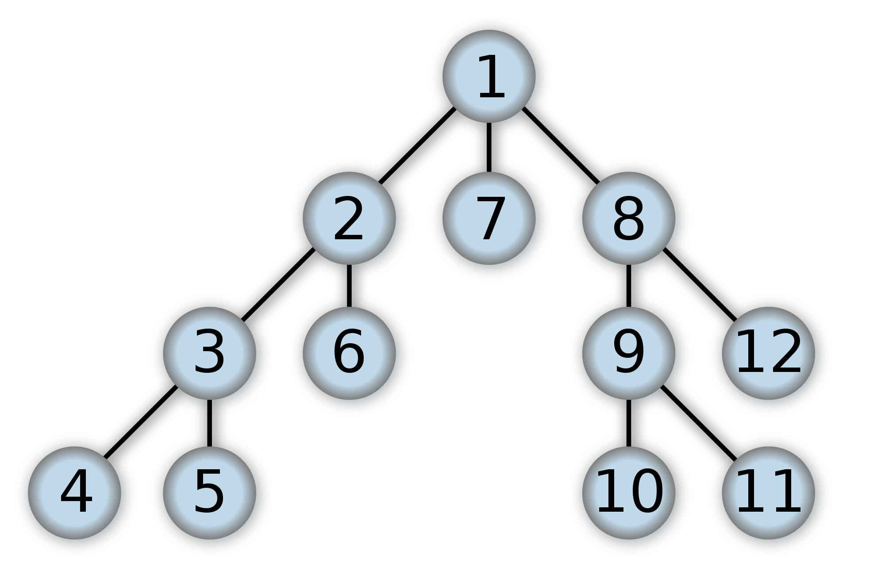
Acyclic-Dependencies Principle
Notes:
Acyclic-Dependencies Principle (ADP) - You stay late to finish up some work, but come in the next morning only to find that your code is broken--someone else stayed later and checked in changes that make your code very unhappy. Fixing your code breaks a third developer's code, and his fixes break yours again. This "morning-after syndrome" can be an unending nightmare of changes breaking other code, which in turn must be changed, which in turn... Cycles begin to make all packages dependent upon all other packages in the system. They dramatically increase build times to the point of pain (something one of us lives with daily on the C++ project he's working). Some languages, like C#, have facilities to prevent circular dependencies among packages. But even modern, dynamic languages like Python can suffer in surprising ways from round-trip dependencies. Dependency cycles among modules are a very serious problem, slowing development and wrecking deadlines. Note that mutual dependencies among classes are usually a problem if the classes are split across modules/packages/assemblies.

Slide 29
Acyclic-Dependencies Principle
1
MyApp
2
3
4
MsgWindw
TaskWindw
MyTasks
5
Database
7
8
Tasks
MyDialogs
6
Windows
Notes:
Acyclic-Dependencies Principle (ADP) - You stay late to finish up some work, but come in the next morning only to find that your code is broken--someone else stayed later and checked in changes that make your code very unhappy. Fixing your code breaks a third developer's code, and his fixes break yours again. This "morning-after syndrome" can be an unending nightmare of changes breaking other code, which in turn must be changed, which in turn... Cycles begin to make all packages dependent upon all other packages in the system. They dramatically increase build times to the point of pain (something one of us lives with daily on the C++ project he's working). Some languages, like C#, have facilities to prevent circular dependencies among packages. But even modern, dynamic languages like Python can suffer in surprising ways from round-trip dependencies. Dependency cycles among modules are a very serious problem, slowing development and wrecking deadlines. Note that mutual dependencies among classes are usually a problem if the classes are split across modules/packages/assemblies.

Slide 30
Acyclic-Dependencies Principle
 | 1 | 2 | 3 | 4 | 5 | 6 | 7 | 8
1 | 0 | 1 | 1 | 1 | 0 | 0 | 0 | 0
2 | 0 | 0 | 0 | 0 | 0 | 1 | 0 | 0
3 | 0 | 0 | 0 | 0 | 0 | 1 | 1 | 1
4 | 0 | 0 | 0 | 0 | 1 | 1 | 1 | 1
5 | 0 | 0 | 0 | 0 | 0 | 0 | 0 | 0
6 | 0 | 0 | 0 | 0 | 0 | 0 | 0 | 0
7 | 0 | 0 | 0 | 0 | 0 | 0 | 0 | 0
8 | 1 | 0 | 0 | 0 | 0 | 1 | 0 | 0
Notes:
Acyclic-Dependencies Principle (ADP) - You stay late to finish up some work, but come in the next morning only to find that your code is broken--someone else stayed later and checked in changes that make your code very unhappy. Fixing your code breaks a third developer's code, and his fixes break yours again. This "morning-after syndrome" can be an unending nightmare of changes breaking other code, which in turn must be changed, which in turn... Cycles begin to make all packages dependent upon all other packages in the system. They dramatically increase build times to the point of pain (something one of us lives with daily on the C++ project he's working). Some languages, like C#, have facilities to prevent circular dependencies among packages. But even modern, dynamic languages like Python can suffer in surprising ways from round-trip dependencies. Dependency cycles among modules are a very serious problem, slowing development and wrecking deadlines. Note that mutual dependencies among classes are usually a problem if the classes are split across modules/packages/assemblies.

Slide 31
Acyclic-Dependencies Principle
How do we break the cycle?
Dependency Inversion Principle
Create a new package and move dependent classes into the new package
Notes:
Acyclic-Dependencies Principle (ADP) - You stay late to finish up some work, but come in the next morning only to find that your code is broken--someone else stayed later and checked in changes that make your code very unhappy. Fixing your code breaks a third developer's code, and his fixes break yours again. This "morning-after syndrome" can be an unending nightmare of changes breaking other code, which in turn must be changed, which in turn... Cycles begin to make all packages dependent upon all other packages in the system. They dramatically increase build times to the point of pain (something one of us lives with daily on the C++ project he's working). Some languages, like C#, have facilities to prevent circular dependencies among packages. But even modern, dynamic languages like Python can suffer in surprising ways from round-trip dependencies. Dependency cycles among modules are a very serious problem, slowing development and wrecking deadlines. Note that mutual dependencies among classes are usually a problem if the classes are split across modules/packages/assemblies.

Slide 32
Acyclic-Dependencies Principle
Class X
Class Y
MyDialogs
MyApp
Class X
Class iY
Class Y
Notes:
Acyclic-Dependencies Principle (ADP) - You stay late to finish up some work, but come in the next morning only to find that your code is broken--someone else stayed later and checked in changes that make your code very unhappy. Fixing your code breaks a third developer's code, and his fixes break yours again. This "morning-after syndrome" can be an unending nightmare of changes breaking other code, which in turn must be changed, which in turn... Cycles begin to make all packages dependent upon all other packages in the system. They dramatically increase build times to the point of pain (something one of us lives with daily on the C++ project he's working). Some languages, like C#, have facilities to prevent circular dependencies among packages. But even modern, dynamic languages like Python can suffer in surprising ways from round-trip dependencies. Dependency cycles among modules are a very serious problem, slowing development and wrecking deadlines. Note that mutual dependencies among classes are usually a problem if the classes are split across modules/packages/assemblies.

Slide 33
Acyclic-Dependencies Principle
1
MyApp
2
3
4
MsgWindw
TaskWindw
MyTasks
5
Database
7
8
Tasks
MyDialogs
6
Windows
newPckg
Notes:
Acyclic-Dependencies Principle (ADP) - You stay late to finish up some work, but come in the next morning only to find that your code is broken--someone else stayed later and checked in changes that make your code very unhappy. Fixing your code breaks a third developer's code, and his fixes break yours again. This "morning-after syndrome" can be an unending nightmare of changes breaking other code, which in turn must be changed, which in turn... Cycles begin to make all packages dependent upon all other packages in the system. They dramatically increase build times to the point of pain (something one of us lives with daily on the C++ project he's working). Some languages, like C#, have facilities to prevent circular dependencies among packages. But even modern, dynamic languages like Python can suffer in surprising ways from round-trip dependencies. Dependency cycles among modules are a very serious problem, slowing development and wrecking deadlines. Note that mutual dependencies among classes are usually a problem if the classes are split across modules/packages/assemblies.

Slide 34
Acyclic-Dependencies Principle
Summary
Dependency graphs should be acyclic
Cycles can be measured using DFS
Cycles can be removed through dependency inversion

Slide 35
Stable-Dependencies Principle
“Depend in the direction of stability”
- Bob Martin
Notes:
Stable-Dependencies Principle (SDP) is based on the understanding that code has volatility, and that changes ripple through a system along dependency lines. From the point-of-view of volatility, dependency is transitive. If the majority of the system's classes are dependent upon a volatile bit of code, then we can expect a high frequency of system breakage and rippling changes. If, instead, a system depends on nonvolatile code, then breakage should not ripple through the system very often at all. Some modules should change frequently, and should be volatile. Other modules are essential core abstractions and should not change very often. Therefore the package dependency graph should flow from instable packages (packages that are easy to change) to stable or "responsible" packages (packages that are hard to change). In a sense, this is the dependency inversion principle applied to packages: You should depend only upon things that are unlikely to change.

Slide 36
Stable-Dependencies Principle
Change is inevitable, we can use the Common-Closure Principle (CCP) to create packages that are sensitive to certain kinds of changes
Notes:
Stable-Dependencies Principle (SDP) is based on the understanding that code has volatility, and that changes ripple through a system along dependency lines. From the point-of-view of volatility, dependency is transitive. If the majority of the system's classes are dependent upon a volatile bit of code, then we can expect a high frequency of system breakage and rippling changes. If, instead, a system depends on nonvolatile code, then breakage should not ripple through the system very often at all. Some modules should change frequently, and should be volatile. Other modules are essential core abstractions and should not change very often. Therefore the package dependency graph should flow from instable packages (packages that are easy to change) to stable or "responsible" packages (packages that are hard to change). In a sense, this is the dependency inversion principle applied to packages: You should depend only upon things that are unlikely to change.

Slide 37
Stable-Dependencies Principle
A package with lots of incoming dependencies is very stable because it takes a great deal of work to change it
Notes:
Stable-Dependencies Principle (SDP) is based on the understanding that code has volatility, and that changes ripple through a system along dependency lines. From the point-of-view of volatility, dependency is transitive. If the majority of the system's classes are dependent upon a volatile bit of code, then we can expect a high frequency of system breakage and rippling changes. If, instead, a system depends on nonvolatile code, then breakage should not ripple through the system very often at all. Some modules should change frequently, and should be volatile. Other modules are essential core abstractions and should not change very often. Therefore the package dependency graph should flow from instable packages (packages that are easy to change) to stable or "responsible" packages (packages that are hard to change). In a sense, this is the dependency inversion principle applied to packages: You should depend only upon things that are unlikely to change.

Slide 38
Stable-Dependencies Principle
X is responsible to these three packages
X
X is independent
Notes:
Stable-Dependencies Principle (SDP) is based on the understanding that code has volatility, and that changes ripple through a system along dependency lines. From the point-of-view of volatility, dependency is transitive. If the majority of the system's classes are dependent upon a volatile bit of code, then we can expect a high frequency of system breakage and rippling changes. If, instead, a system depends on nonvolatile code, then breakage should not ripple through the system very often at all. Some modules should change frequently, and should be volatile. Other modules are essential core abstractions and should not change very often. Therefore the package dependency graph should flow from instable packages (packages that are easy to change) to stable or "responsible" packages (packages that are hard to change). In a sense, this is the dependency inversion principle applied to packages: You should depend only upon things that are unlikely to change.

Slide 39
Stable-Dependencies Principle
Y is irresponsible
Y
Y is dependent
Notes:
Stable-Dependencies Principle (SDP) is based on the understanding that code has volatility, and that changes ripple through a system along dependency lines. From the point-of-view of volatility, dependency is transitive. If the majority of the system's classes are dependent upon a volatile bit of code, then we can expect a high frequency of system breakage and rippling changes. If, instead, a system depends on nonvolatile code, then breakage should not ripple through the system very often at all. Some modules should change frequently, and should be volatile. Other modules are essential core abstractions and should not change very often. Therefore the package dependency graph should flow from instable packages (packages that are easy to change) to stable or "responsible" packages (packages that are hard to change). In a sense, this is the dependency inversion principle applied to packages: You should depend only upon things that are unlikely to change.

Slide 40
Stable-Dependencies Principle
Stability Metrics
Ca = Afferent Coupling: Number of classes outside the package that depend on classes inside
Ce = Efferent Coupling: Number of classes inside the package that depend on classes outside
I = Instability = Ce / (Ca + Ce)
Notes:
Stable-Dependencies Principle (SDP) is based on the understanding that code has volatility, and that changes ripple through a system along dependency lines. From the point-of-view of volatility, dependency is transitive. If the majority of the system's classes are dependent upon a volatile bit of code, then we can expect a high frequency of system breakage and rippling changes. If, instead, a system depends on nonvolatile code, then breakage should not ripple through the system very often at all. Some modules should change frequently, and should be volatile. Other modules are essential core abstractions and should not change very often. Therefore the package dependency graph should flow from instable packages (packages that are easy to change) to stable or "responsible" packages (packages that are hard to change). In a sense, this is the dependency inversion principle applied to packages: You should depend only upon things that are unlikely to change.

Slide 41
Stable-Dependencies Principle
A
B
Q
R
S
Package C Metrics
Ca = 3
Ce = 1
I = 1/4
C
D
T
U
V
Notes:
Stable-Dependencies Principle (SDP) is based on the understanding that code has volatility, and that changes ripple through a system along dependency lines. From the point-of-view of volatility, dependency is transitive. If the majority of the system's classes are dependent upon a volatile bit of code, then we can expect a high frequency of system breakage and rippling changes. If, instead, a system depends on nonvolatile code, then breakage should not ripple through the system very often at all. Some modules should change frequently, and should be volatile. Other modules are essential core abstractions and should not change very often. Therefore the package dependency graph should flow from instable packages (packages that are easy to change) to stable or "responsible" packages (packages that are hard to change). In a sense, this is the dependency inversion principle applied to packages: You should depend only upon things that are unlikely to change.

Slide 42
Demo: Package Metrics
Notes:
Stable-Dependencies Principle (SDP) is based on the understanding that code has volatility, and that changes ripple through a system along dependency lines. From the point-of-view of volatility, dependency is transitive. If the majority of the system's classes are dependent upon a volatile bit of code, then we can expect a high frequency of system breakage and rippling changes. If, instead, a system depends on nonvolatile code, then breakage should not ripple through the system very often at all. Some modules should change frequently, and should be volatile. Other modules are essential core abstractions and should not change very often. Therefore the package dependency graph should flow from instable packages (packages that are easy to change) to stable or "responsible" packages (packages that are hard to change). In a sense, this is the dependency inversion principle applied to packages: You should depend only upon things that are unlikely to change.

Slide 43
Stable-Dependencies Principle
Summary
Responsible, dependent packages are stable
We can calculate Instability
Not all packages should be stable, if they were the system would be unchangeable
Notes:
Stable-Dependencies Principle (SDP) is based on the understanding that code has volatility, and that changes ripple through a system along dependency lines. From the point-of-view of volatility, dependency is transitive. If the majority of the system's classes are dependent upon a volatile bit of code, then we can expect a high frequency of system breakage and rippling changes. If, instead, a system depends on nonvolatile code, then breakage should not ripple through the system very often at all. Some modules should change frequently, and should be volatile. Other modules are essential core abstractions and should not change very often. Therefore the package dependency graph should flow from instable packages (packages that are easy to change) to stable or "responsible" packages (packages that are hard to change). In a sense, this is the dependency inversion principle applied to packages: You should depend only upon things that are unlikely to change.

Slide 44
Stable-Abstractions Principle
“A package should be as abstract as it is stable”
- Bob Martin
Notes:
Stable-Abstractions Principle (SAP) - Per Uncle Bob, this principle sets up a relationship between stability and abstraction. A stable package should be as abstract as possible, thus ensuring that its "stability does not prevent it from being extended." In contrast, an instable (not responsible) package should contain lots of concrete classes whose details can be easily changed. This further reflects the Stable Dependencies principle, with the added observation that the reason for interfaces is to give safe, stable dependencies to clients of an abstraction. This drives us to the understanding that we should depend on the parts of the system built specifically to provide freedom from volatile bits (implementations). In dynamic languages, SAP is a harder metric to automate. Clearly the principle still applies. There will be classes whose purpose is to provide a stable interface and other classes that provide easily-changeable behaviors. The only problem is that not having declared interfaces makes it harder to automate the process of assessing abstractness.

Slide 45
Stable-Abstractions Principle
A stable package should be abstract so that its stability does not prevent it from being extended
Notes:
Stable-Abstractions Principle (SAP) - Per Uncle Bob, this principle sets up a relationship between stability and abstraction. A stable package should be as abstract as possible, thus ensuring that its "stability does not prevent it from being extended." In contrast, an instable (not responsible) package should contain lots of concrete classes whose details can be easily changed. This further reflects the Stable Dependencies principle, with the added observation that the reason for interfaces is to give safe, stable dependencies to clients of an abstraction. This drives us to the understanding that we should depend on the parts of the system built specifically to provide freedom from volatile bits (implementations). In dynamic languages, SAP is a harder metric to automate. Clearly the principle still applies. There will be classes whose purpose is to provide a stable interface and other classes that provide easily-changeable behaviors. The only problem is that not having declared interfaces makes it harder to automate the process of assessing abstractness.

Slide 46
Stable-Abstractions Principle
SAP + SDP = DIP for packages
SDP says that dependencies should run in the direction of stability, and SAP says that stability implies abstraction -> Dependencies run in the direction of abstraction
Notes:
Stable-Abstractions Principle (SAP) - Per Uncle Bob, this principle sets up a relationship between stability and abstraction. A stable package should be as abstract as possible, thus ensuring that its "stability does not prevent it from being extended." In contrast, an instable (not responsible) package should contain lots of concrete classes whose details can be easily changed. This further reflects the Stable Dependencies principle, with the added observation that the reason for interfaces is to give safe, stable dependencies to clients of an abstraction. This drives us to the understanding that we should depend on the parts of the system built specifically to provide freedom from volatile bits (implementations). In dynamic languages, SAP is a harder metric to automate. Clearly the principle still applies. There will be classes whose purpose is to provide a stable interface and other classes that provide easily-changeable behaviors. The only problem is that not having declared interfaces makes it harder to automate the process of assessing abstractness.

Slide 47
Stable-Abstractions Principle
Measuring Abstraction
Nc = Number of classes in the package
Na = Number of abstract classes in the package
A = Na / Nc
Notes:
Stable-Abstractions Principle (SAP) - Per Uncle Bob, this principle sets up a relationship between stability and abstraction. A stable package should be as abstract as possible, thus ensuring that its "stability does not prevent it from being extended." In contrast, an instable (not responsible) package should contain lots of concrete classes whose details can be easily changed. This further reflects the Stable Dependencies principle, with the added observation that the reason for interfaces is to give safe, stable dependencies to clients of an abstraction. This drives us to the understanding that we should depend on the parts of the system built specifically to provide freedom from volatile bits (implementations). In dynamic languages, SAP is a harder metric to automate. Clearly the principle still applies. There will be classes whose purpose is to provide a stable interface and other classes that provide easily-changeable behaviors. The only problem is that not having declared interfaces makes it harder to automate the process of assessing abstractness.

Slide 48
Stable-Abstractions Principle
What is an abstract class in LabVIEW?
Any Class with at least one abstract method?
Notes:
Stable-Abstractions Principle (SAP) - Per Uncle Bob, this principle sets up a relationship between stability and abstraction. A stable package should be as abstract as possible, thus ensuring that its "stability does not prevent it from being extended." In contrast, an instable (not responsible) package should contain lots of concrete classes whose details can be easily changed. This further reflects the Stable Dependencies principle, with the added observation that the reason for interfaces is to give safe, stable dependencies to clients of an abstraction. This drives us to the understanding that we should depend on the parts of the system built specifically to provide freedom from volatile bits (implementations). In dynamic languages, SAP is a harder metric to automate. Clearly the principle still applies. There will be classes whose purpose is to provide a stable interface and other classes that provide easily-changeable behaviors. The only problem is that not having declared interfaces makes it harder to automate the process of assessing abstractness.

Slide 49
Stable-Abstractions Principle
Distance from the Main Sequence
D = |A + I - 1|
(0,1)
(1,1)
Zone of Pain
Zone of Uselessness
A
(0,0)
I
(1,0)
Notes:
Stable-Abstractions Principle (SAP) - Per Uncle Bob, this principle sets up a relationship between stability and abstraction. A stable package should be as abstract as possible, thus ensuring that its "stability does not prevent it from being extended." In contrast, an instable (not responsible) package should contain lots of concrete classes whose details can be easily changed. This further reflects the Stable Dependencies principle, with the added observation that the reason for interfaces is to give safe, stable dependencies to clients of an abstraction. This drives us to the understanding that we should depend on the parts of the system built specifically to provide freedom from volatile bits (implementations). In dynamic languages, SAP is a harder metric to automate. Clearly the principle still applies. There will be classes whose purpose is to provide a stable interface and other classes that provide easily-changeable behaviors. The only problem is that not having declared interfaces makes it harder to automate the process of assessing abstractness.

Slide 50
Demo: Package Metrics
Notes:
Stable-Dependencies Principle (SDP) is based on the understanding that code has volatility, and that changes ripple through a system along dependency lines. From the point-of-view of volatility, dependency is transitive. If the majority of the system's classes are dependent upon a volatile bit of code, then we can expect a high frequency of system breakage and rippling changes. If, instead, a system depends on nonvolatile code, then breakage should not ripple through the system very often at all. Some modules should change frequently, and should be volatile. Other modules are essential core abstractions and should not change very often. Therefore the package dependency graph should flow from instable packages (packages that are easy to change) to stable or "responsible" packages (packages that are hard to change). In a sense, this is the dependency inversion principle applied to packages: You should depend only upon things that are unlikely to change.

Slide 51
Summary
Packages provide high level organization for large LabVIEW applications
Package cohesion is a balance between usability and developability
Package coupling can be measured
Package design happens after classes and their interconnectedness have been created, and evolves as the application changes
Notes:
Stable-Dependencies Principle (SDP) is based on the understanding that code has volatility, and that changes ripple through a system along dependency lines. From the point-of-view of volatility, dependency is transitive. If the majority of the system's classes are dependent upon a volatile bit of code, then we can expect a high frequency of system breakage and rippling changes. If, instead, a system depends on nonvolatile code, then breakage should not ripple through the system very often at all. Some modules should change frequently, and should be volatile. Other modules are essential core abstractions and should not change very often. Therefore the package dependency graph should flow from instable packages (packages that are easy to change) to stable or "responsible" packages (packages that are hard to change). In a sense, this is the dependency inversion principle applied to packages: You should depend only upon things that are unlikely to change.

